Slide 1




Matthew McAuley

Slide 2
Battlefield 4
Battlefield 4 is a first person shooter developed for PlayStation, Xbox and PC.
It was developed by DICE which are a video game development company owned by Electronic Arts.
The game is still very popular today even though it was released in 2013 but maybe not the best in terms of the franchise.
I still feel the visuals and gameplay can stand up to any game on the market today as it still a fun and engaging game.
This is down to the engine that was used to create the game which was frostbite 3. At time the game was released the engine was the best on the market and still is one of the leading game engines with the most recent game to use the engine being FiFa 17

Slide 3
Frostbite 3
Frostbite 3 is a game engine that was developed in house by digital Illusions or DICE.
The visuals in frostbite 3 give a whole knew look to games making them look beautiful and incredibly realistic.
Frostbite 3 offers the player with an advance lighting system along with a built in global weather system which dynamically changes and effects the environment and gameplay.
The engine also provides you with physics that are close to real life as seen with the levolution of buildings and the landscape in battlefield 4.
Frostbite 3 - https://youtu.be/fBecEtNAavQ

Slide 4
Gameplay
The gameplay in battlefield make it one of the leading games on the market in terms of first person shooters. It provides the player with a semi realistic view of what war could be like and the chaos it conveys.
The frostbite engine plays a big part in bringing the realism to the player and having an engine with this much capability means the developers can do more with the gameplay. The took advantage of these features with the dynamic events that completely change the map and having it so nearly every object in the game level can be destroyed including the landscape.
Game play - https://youtu.be/1FC3ve0c8oo?t=2m13s

Slide 5
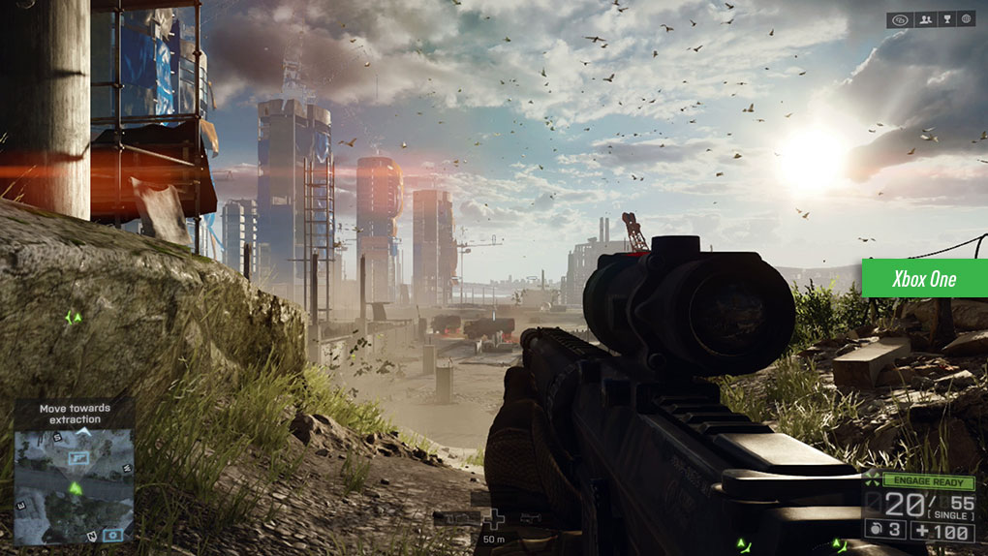
Lighting
To me a stand out feature of battlefield is the lighting system that the engine provides as it makes everything in the world have a sense of realism and shows off the detail that has went into the game. It also works perfectly with the weather system to show off the massive and very beautiful landscape in both single and multiplayer.
Lens flare happens in real life too..

Slide 6
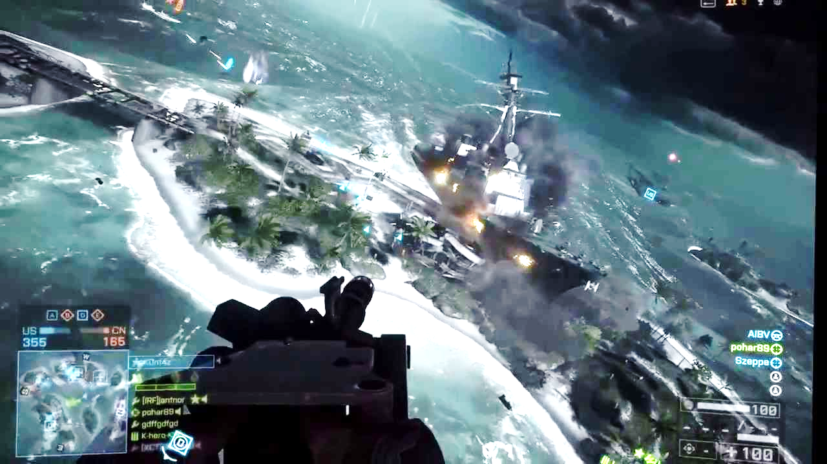
Physics
The physics in battlefield have been important throughout the franchise and the frostbite engine has progressed with battlefield as the development of the battlefield franchise has needed more powerful and better engine.
As I have mentioned the best way to show off the physics in battlefield is the levolution aspects of the game and the weather system which interacts with all parts of the level completely changing the gameplay in some cases.
Levolution - https://www.youtube.com/watch?v=Q3W4FbsAqIY

Slide 7
References
http://www.cinemablend.com/games/Battlefield-4-Frostbite-3-Video-Notes-How-Destruction-Physics-Evolved-56985.html
https://www.youtube.com/watch?v=fBecEtNAavQ
http://www.frostbite.com/about/mission/
https://www.youtube.com/watch?v=Q3W4FbsAqIY
http://www.bit-tech.net/hardware/graphics/2013/11/27/battlefield-4-performance-analysis/1

Slide 8
Questions?

